Slide 1

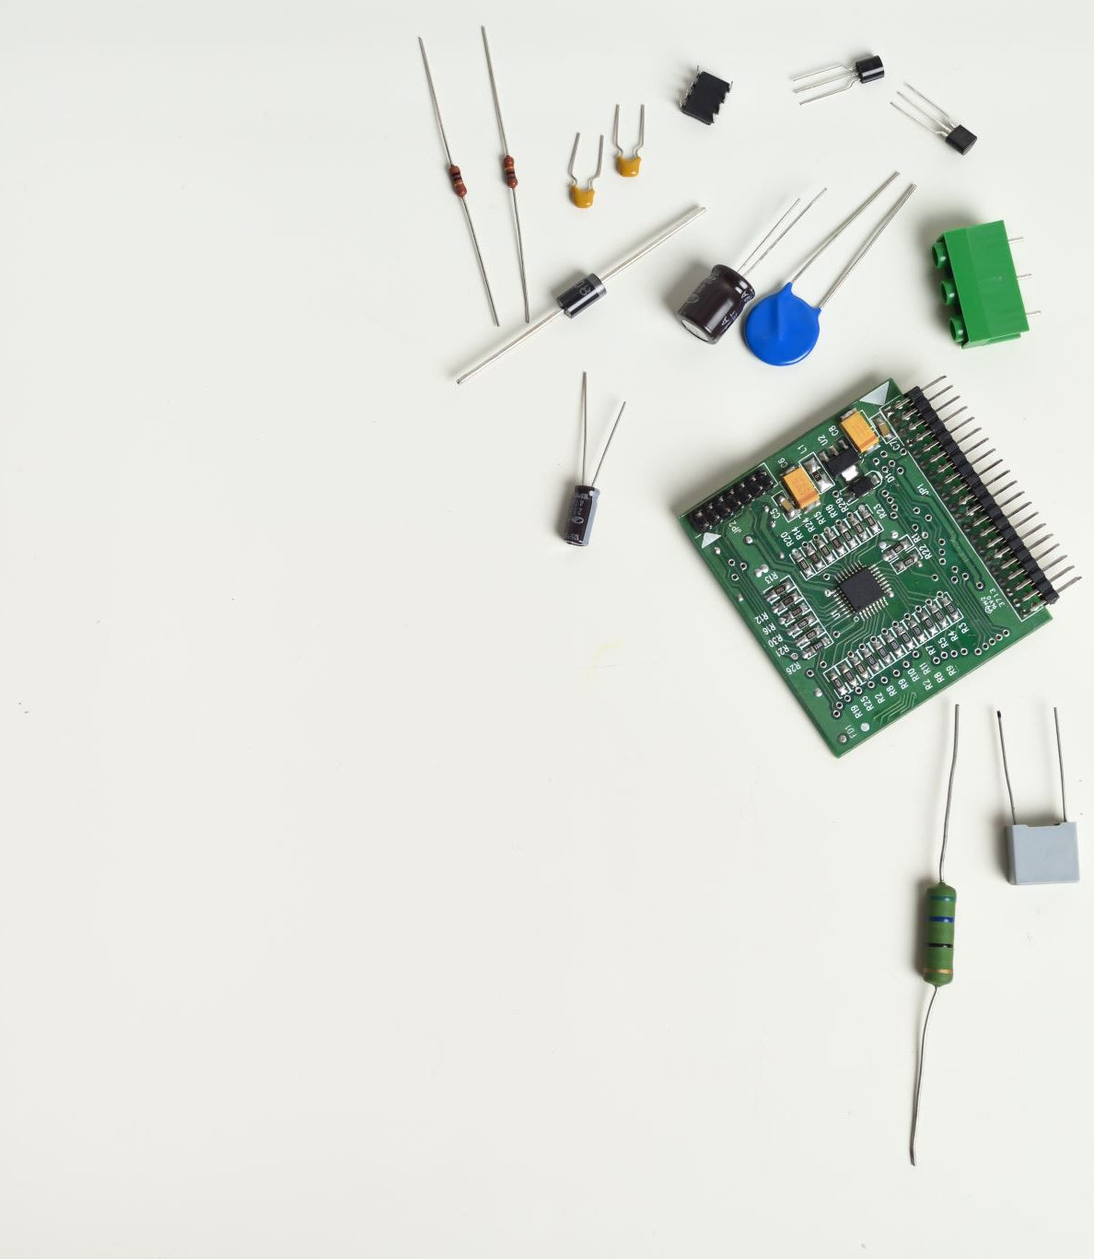
CEIS101
IoT Home Security system
Nolan Broughton

Slide 2

Introduction
The Internet of things is growing exponentially
This Project combines an aspect of the internet of things to develop a home security system

Slide 3
Inventory for the Home security system
Audrino mega board
Resistor 220
LED
Breadboard
Motion sensor
Wires
Buzzer
ESP32 board

Slide 4
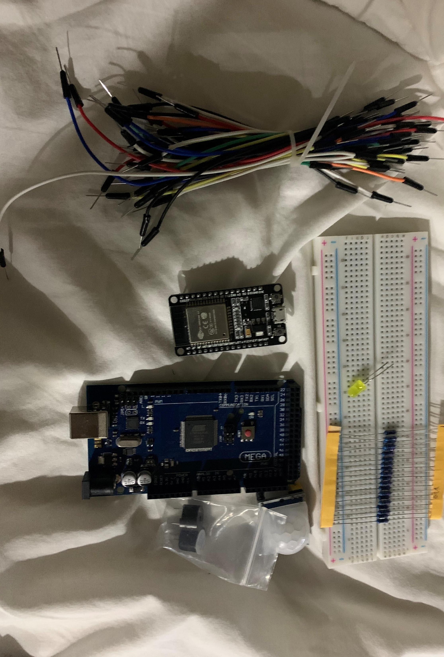
Picture of Inventory

Slide 5
Planning and design
I realize that planning and creating a flowchart is essential to starting any project
I used a flowchart to help design my system
I determined the systems input/processing/output

Slide 6
What are flowcharts
A flowchart is a type of diagram that represents a workflow or process.
A flowchart can also be used to show a step by step approach to solving a task.

Slide 7
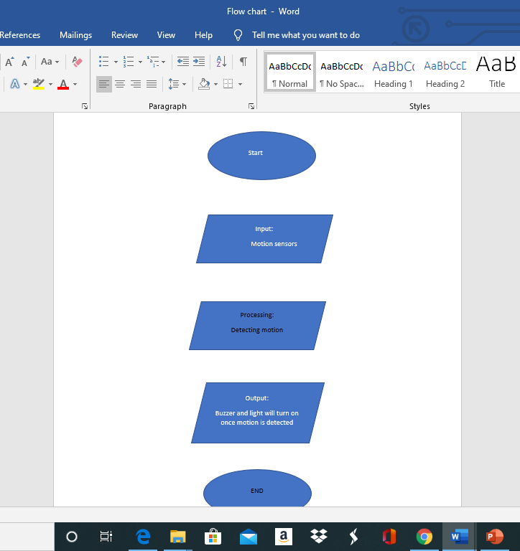
Picture of flowchart

Slide 8

Input- Processing- Output
Input – Motion
Process- system awaits until motion is detected, when motion is detected system alerts user
Output- Buzzer

Slide 9
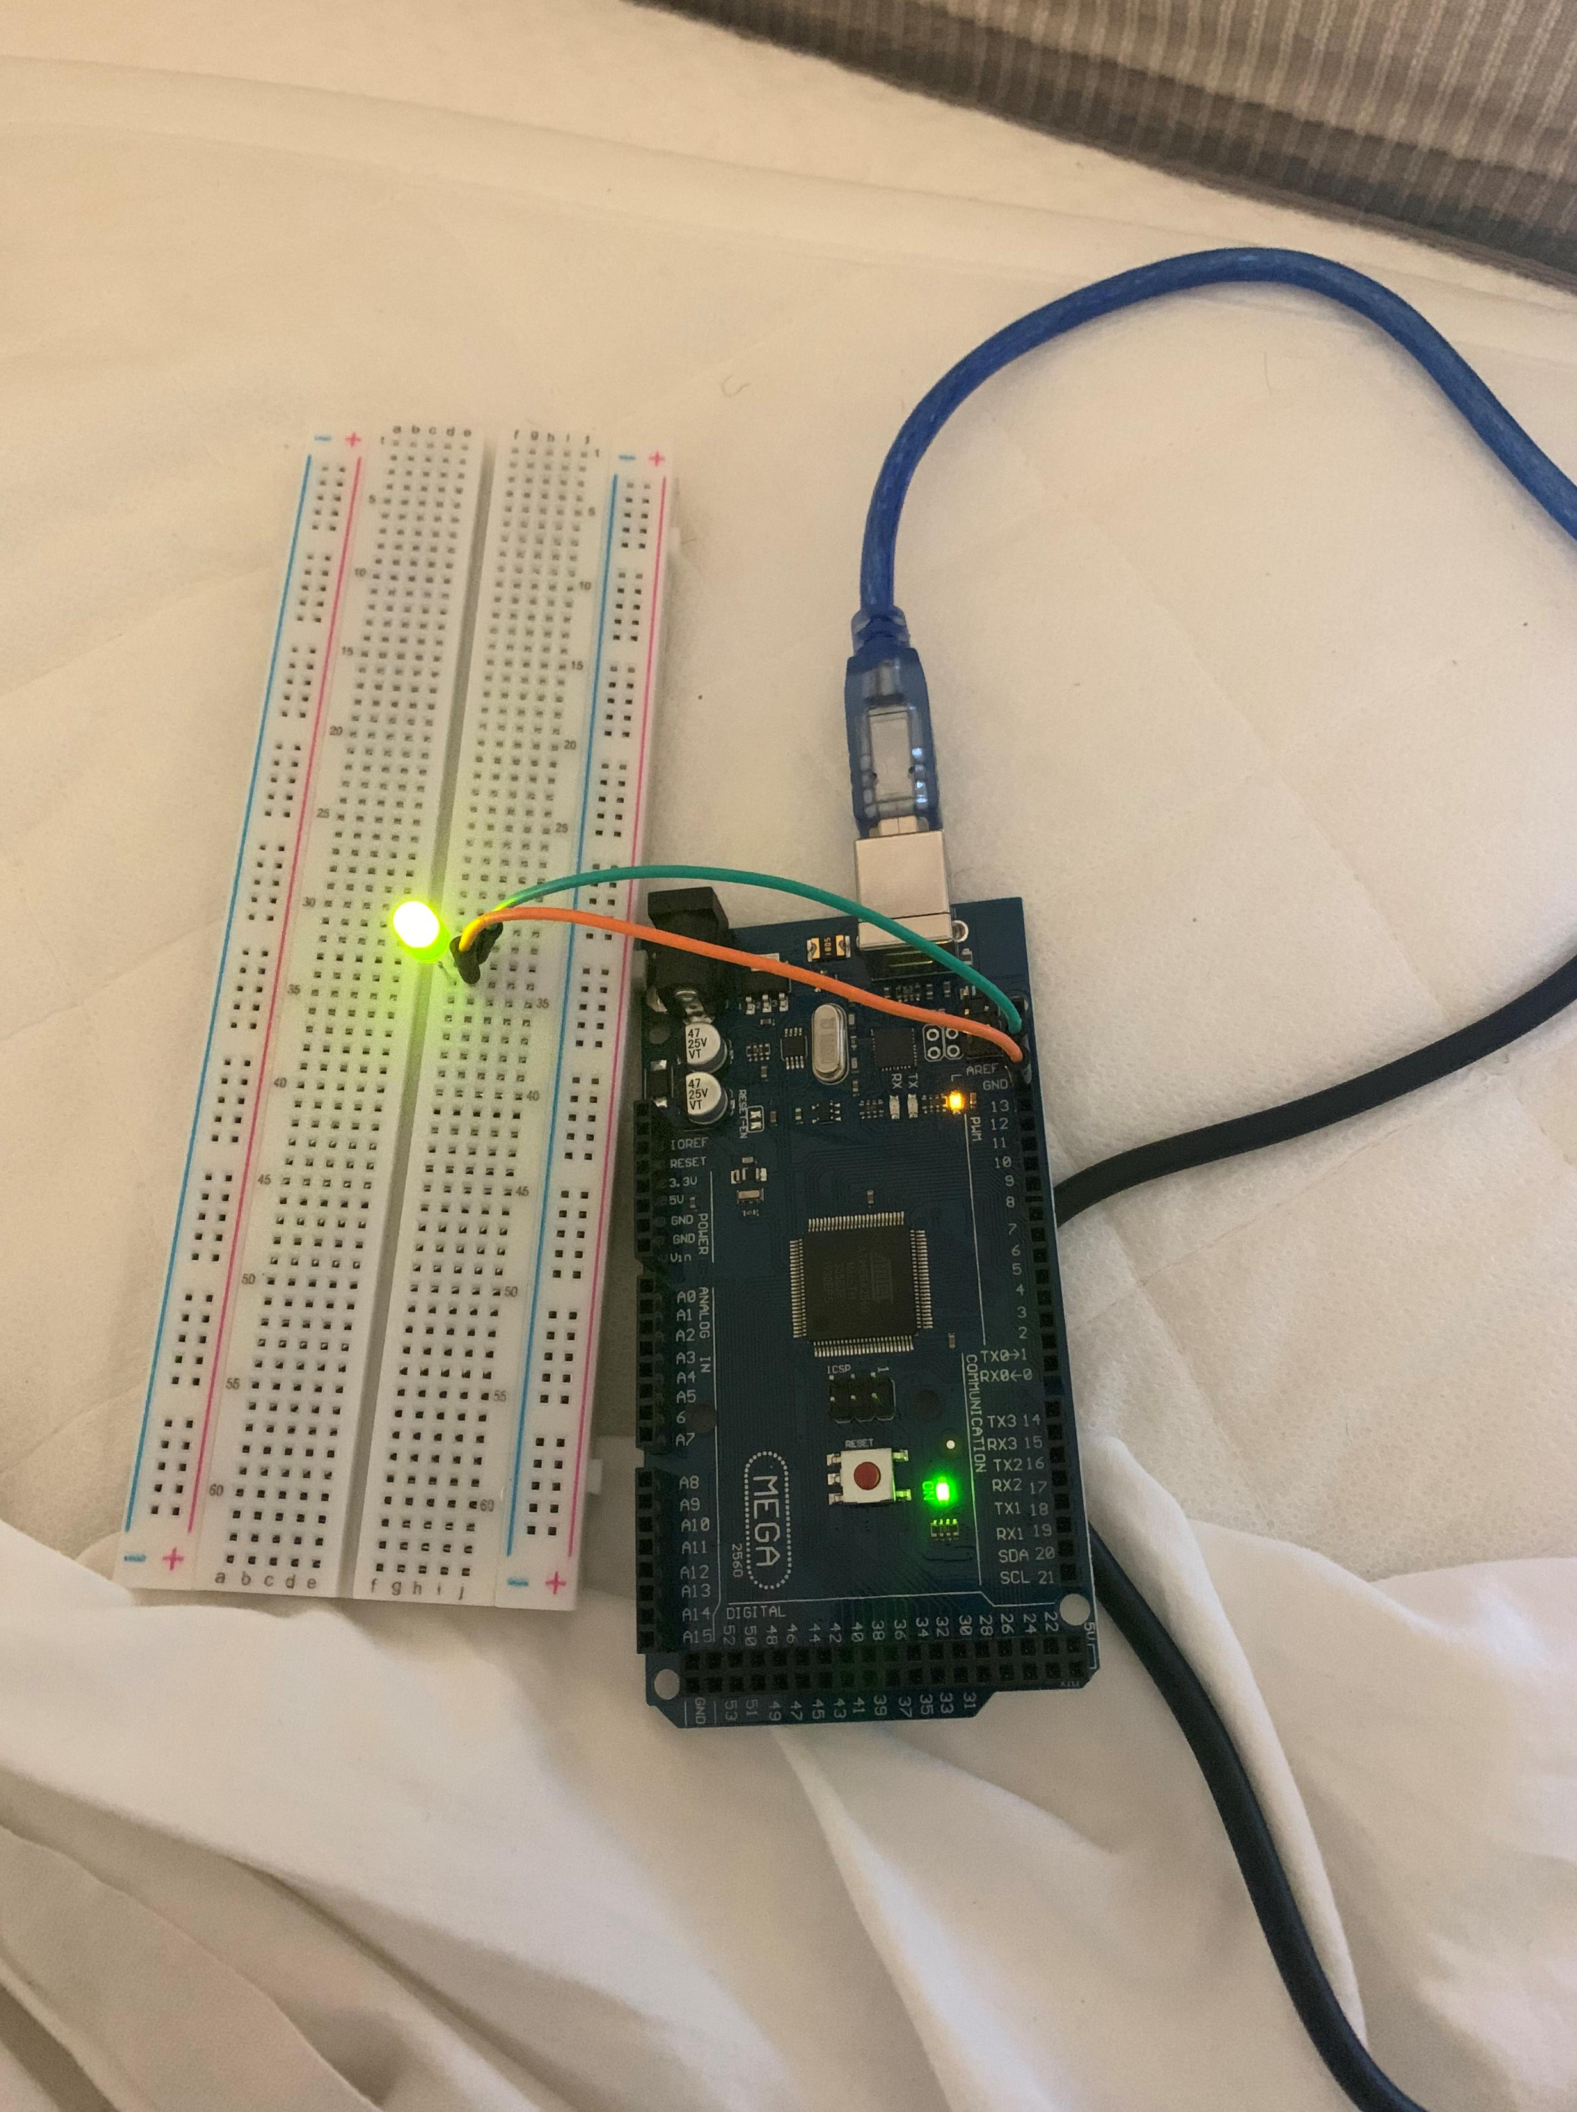
Picture of circuit

Slide 10
Setting up Arduino
The Arduino IDE is an integrated development environment where you’re able to write programs that control hardware
To set this up I first went to audrino.cc go download for files for the software
Once you open the file and accept all the default it’ll start to extract and install all the files on to your computer
Once I installed and opened my Arduino, I made sure I had the correct board hooked up by going to the tools tab>board
I am using the Arduino mega 2560
Also I made sure I used the correct port

Slide 11
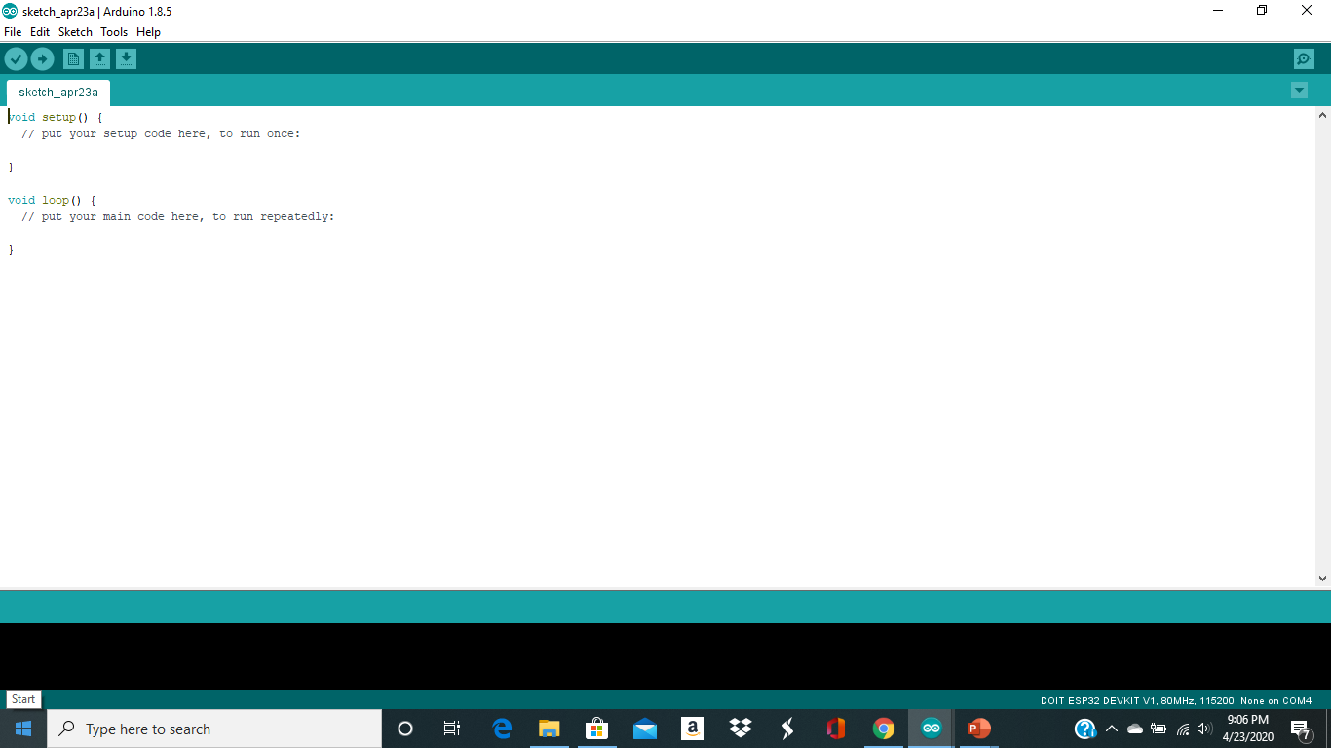
Screenshot of Arduino

Slide 12
Adding the motion sensor and buzzer
I began to add the motion sensor and the buzzer with the LED light I wanted to make it so where that when the motion sensor detects motion it will alert us by the buzzer making a sound and the light flashing
We’d be able to use code in the Arduino IDE to control the Hardware

Slide 13
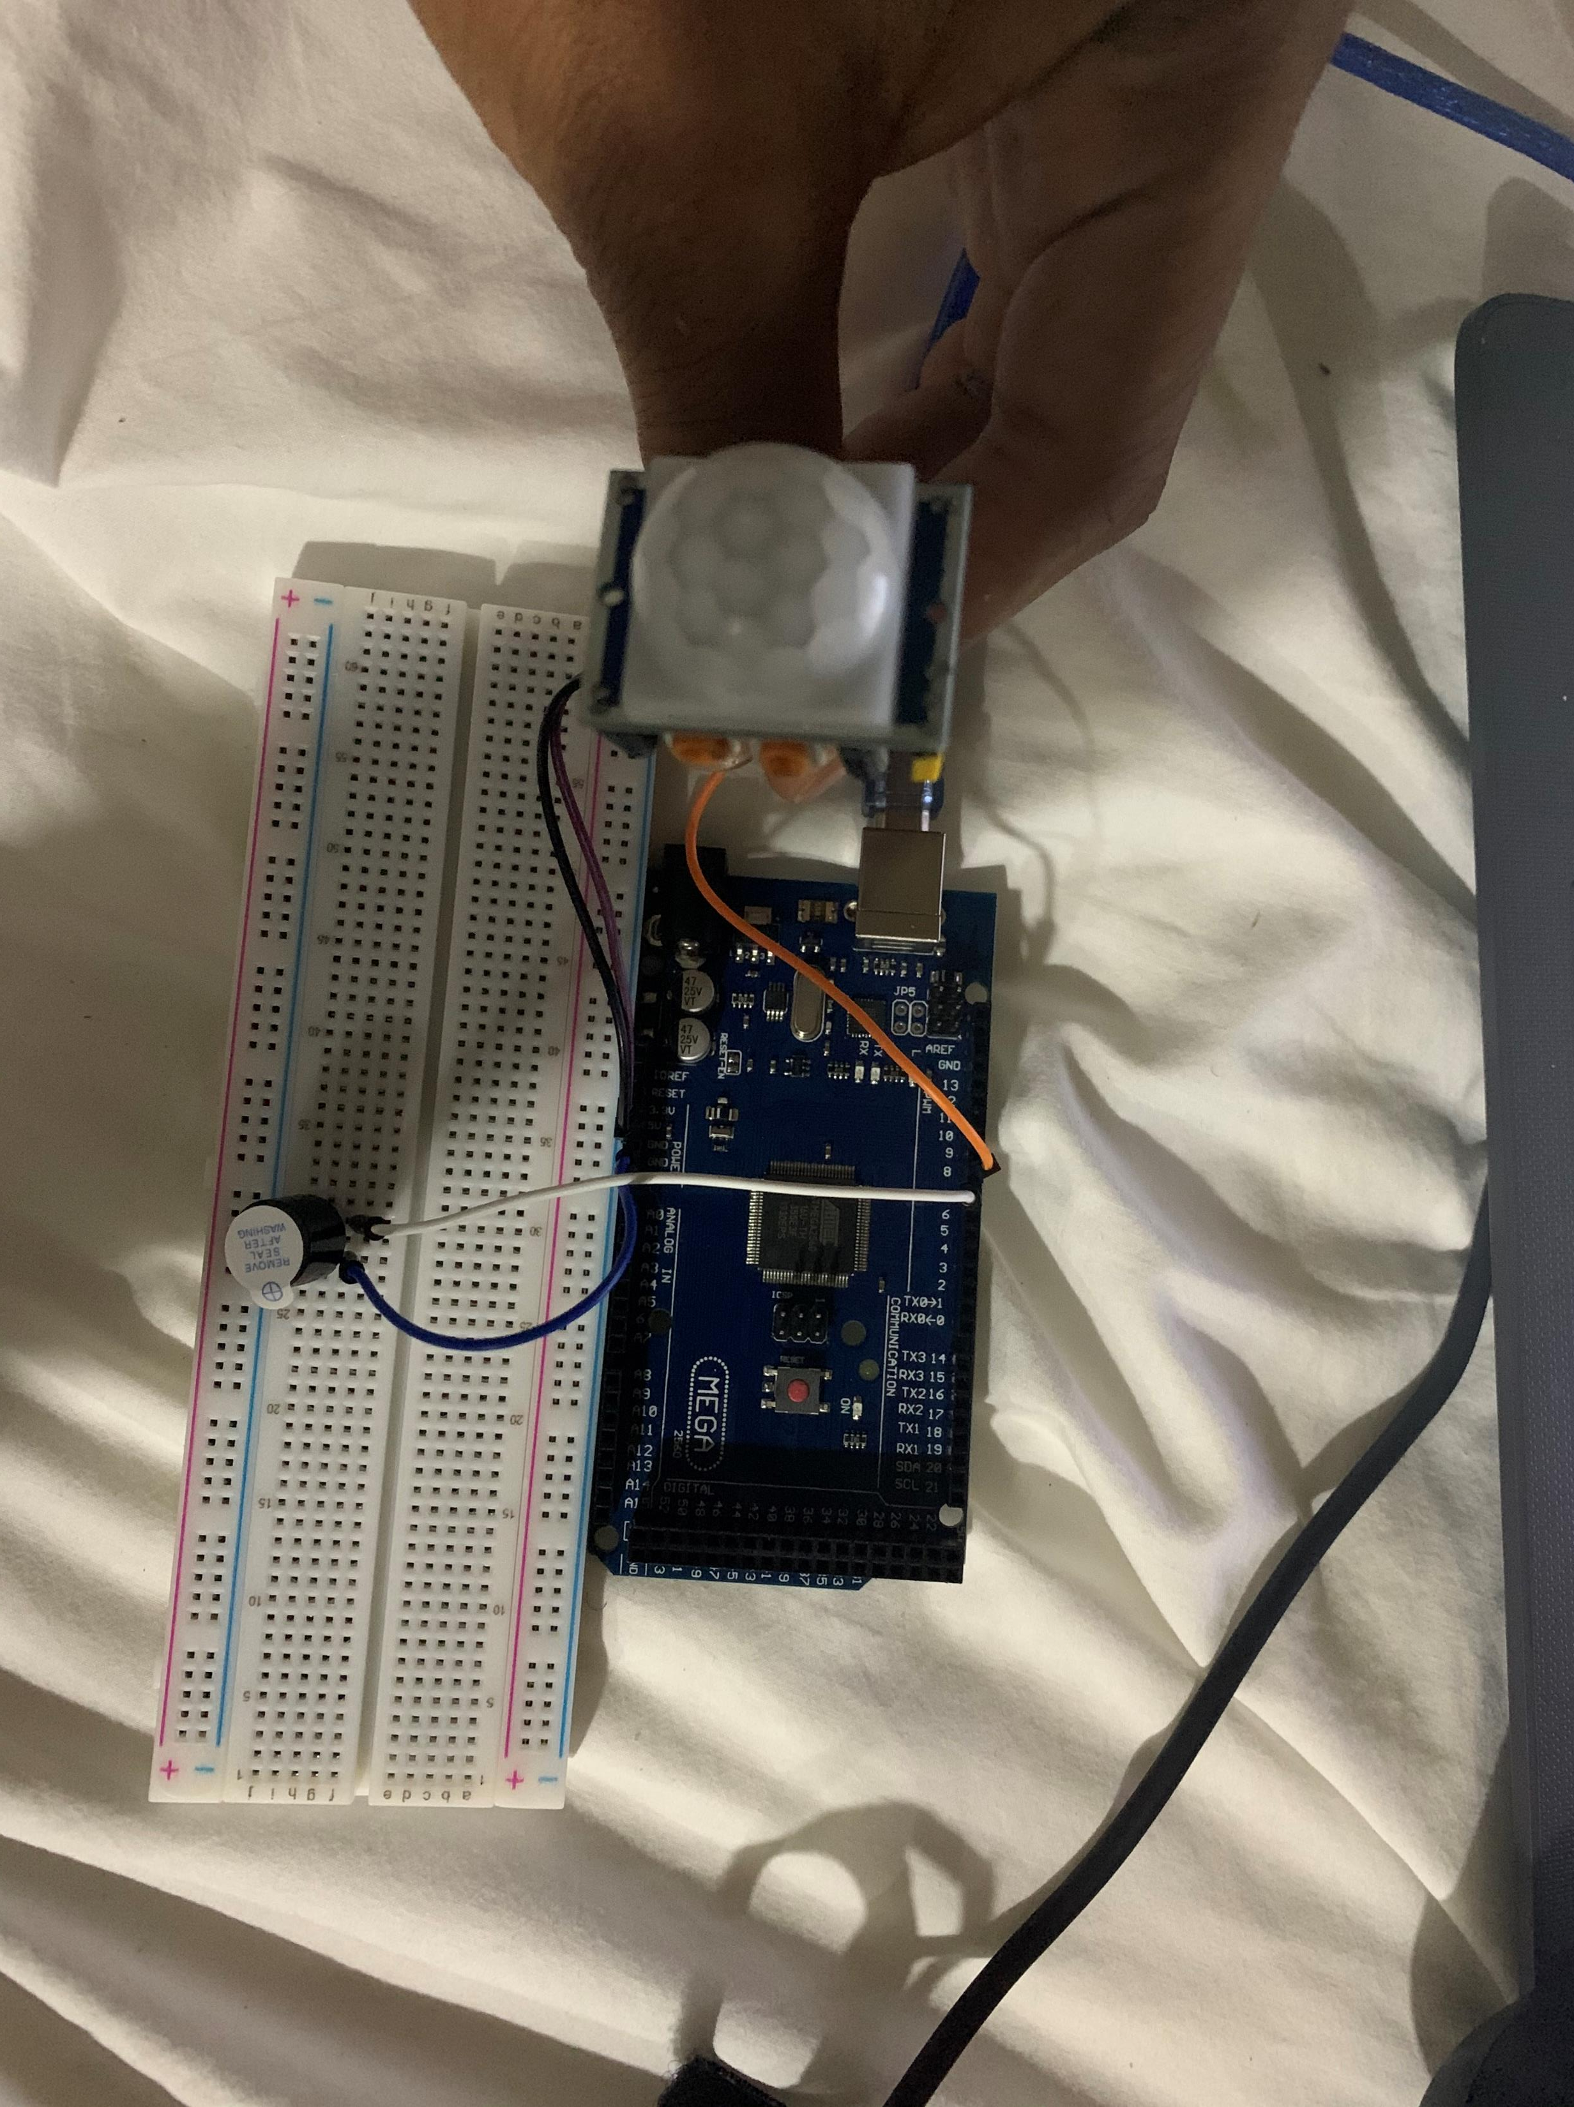
Picture of circuit with motion sensor and buzzer

Slide 14
Code explanation
In the code pin 7 is setup as the output based on the pinMode () function
Pin 8 is set up as the input which connected to the motion sensor
The Audrino setup () function will run one time setting the input and output pins

Slide 15
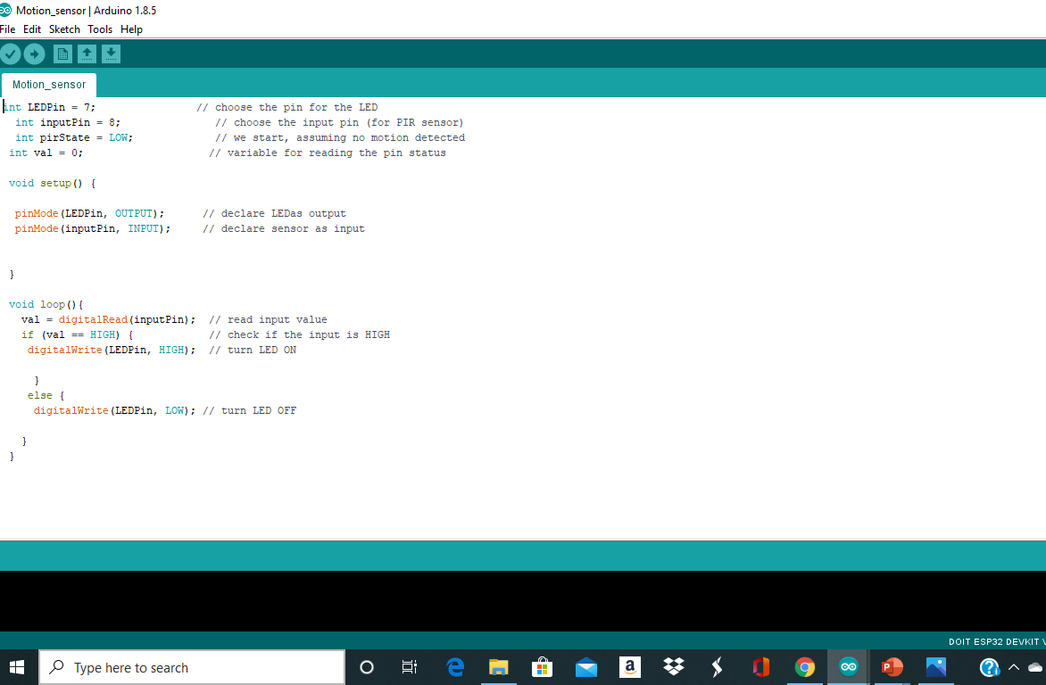
Picture of code

Slide 16

Explanation of serial monitor
The serial monitor is a separate pop up window that acts as separate terminal that communicates by receiving and sending serial data
Using the serial monitor I was able to see the data being produced from my motion sensor

Slide 17
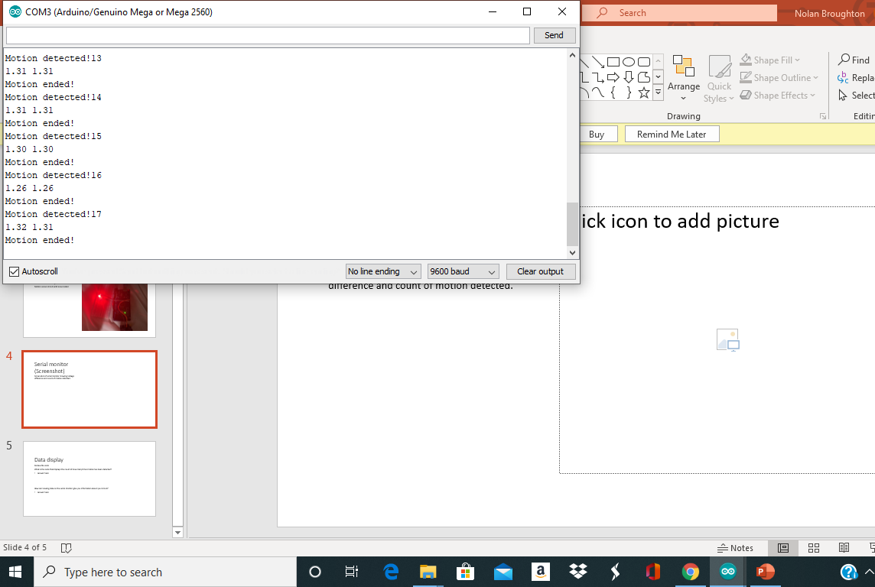
Serial monitor with picture

Slide 18
Networking and security
The networking part of this project was mainly setting up the router so I would have a network for my webpage to control my home security system from my computer or phone

Slide 19
Setting up the Router
I used the router to set up the network for my webpage so I could control my home security system from my computer or phone
To do this I Hooked up the router through usb to my computer then I went to my wifi settings and connected to it
I proceeded by going to the website on the router and changing SSID and password of the router
Then I went into my Audrino IDE to the serial Monitor and made sure it was picking up the Wifi from my router

Slide 20
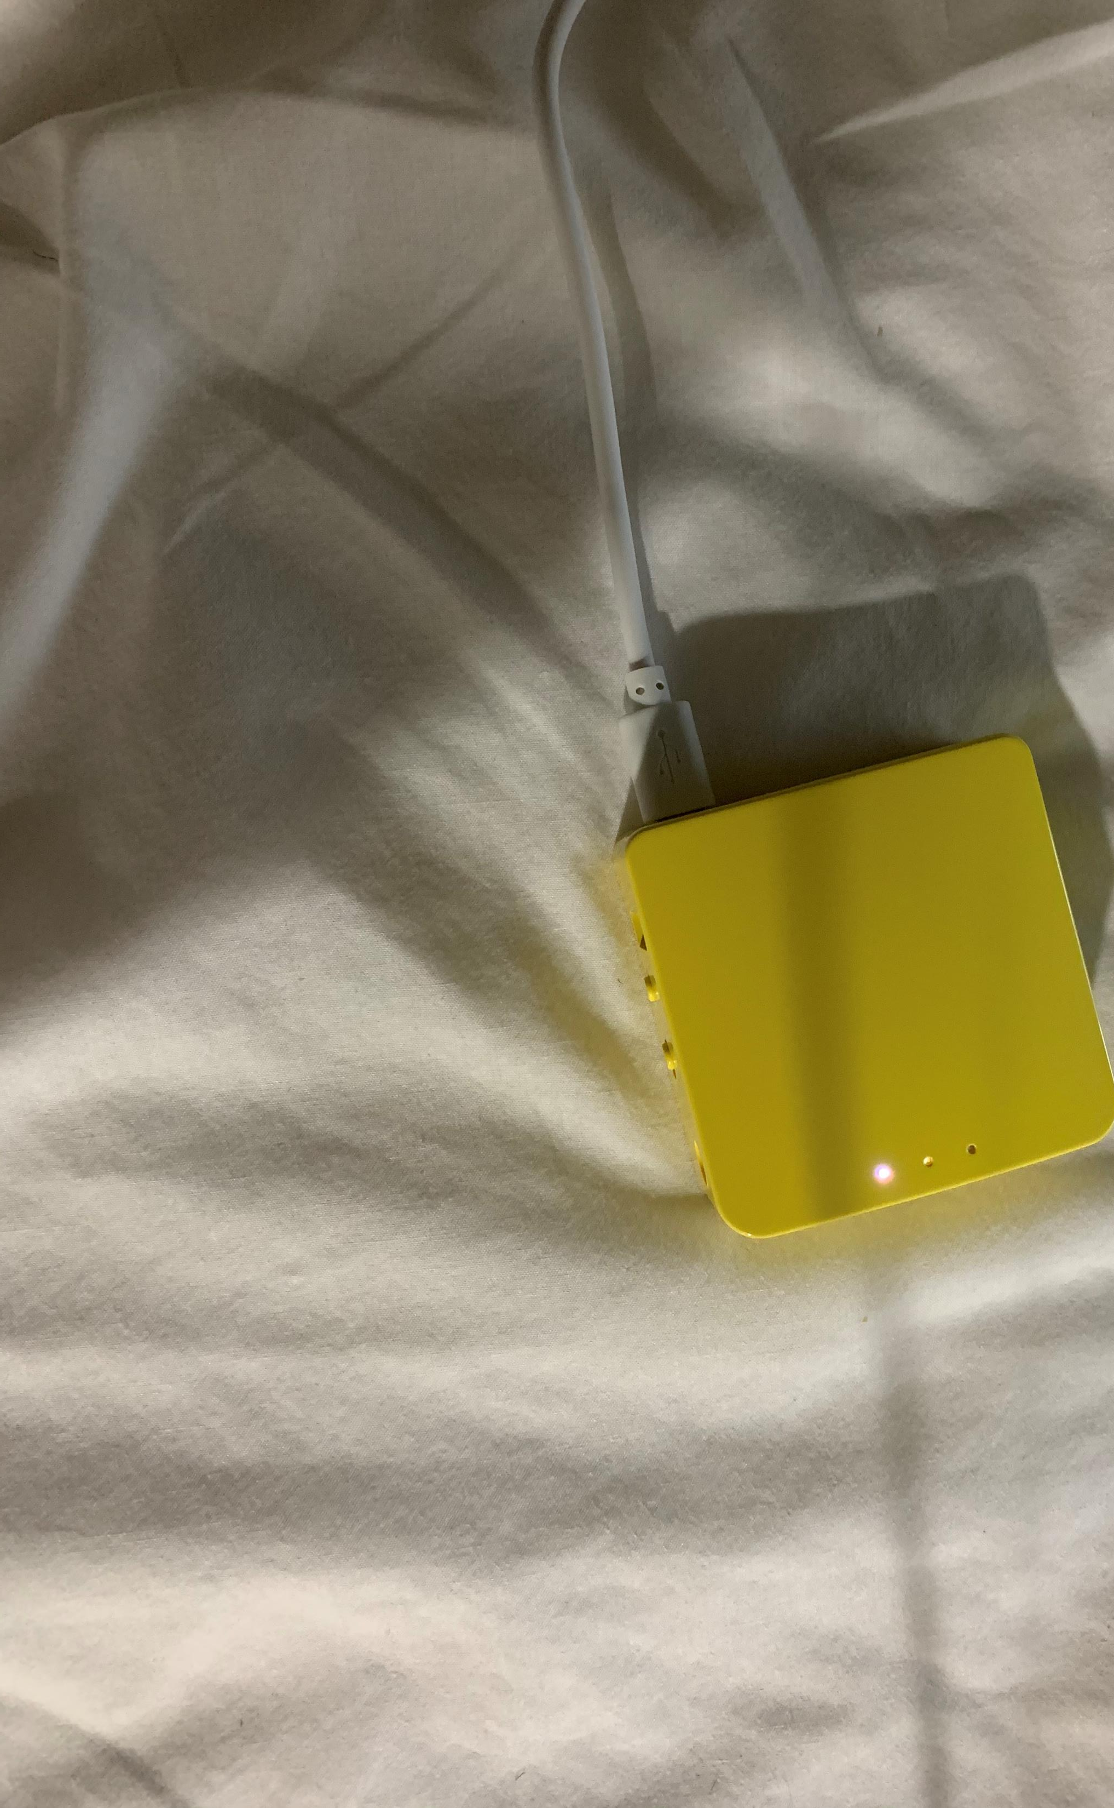
Picture of router

Slide 21
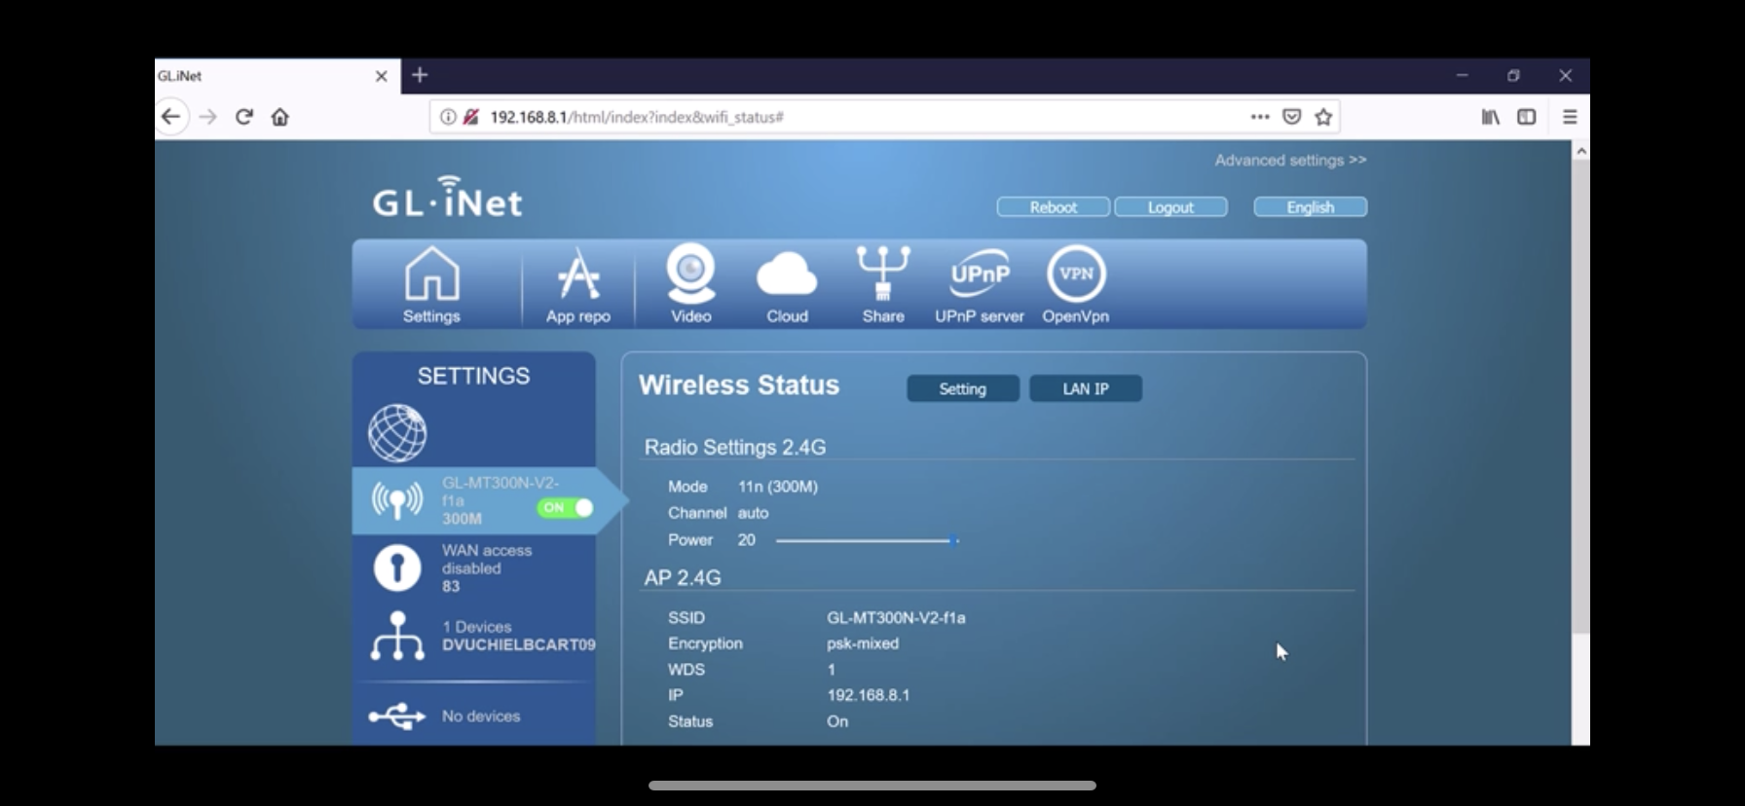
Picture of Router Website

Slide 22
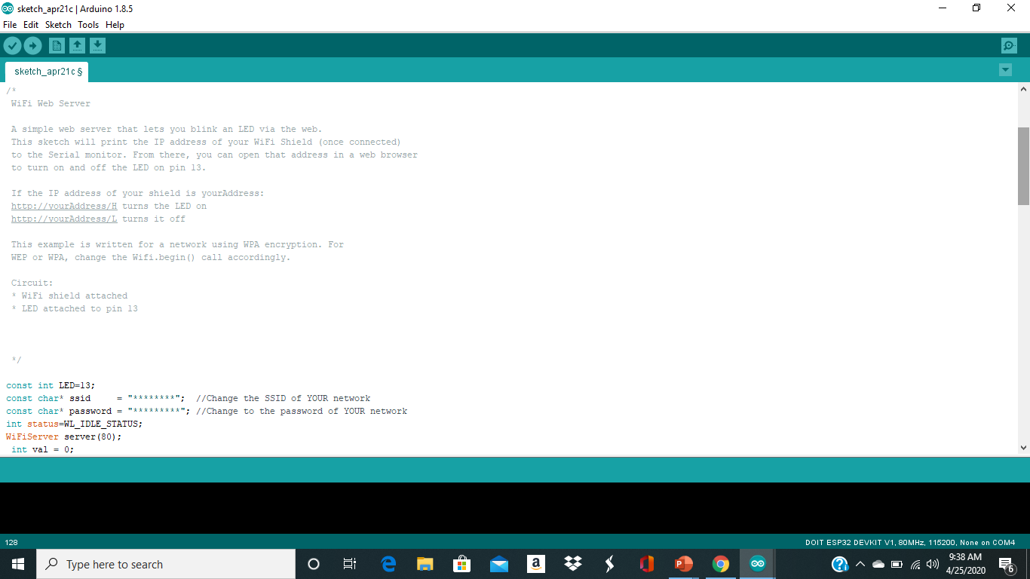
Code for webpage

Slide 23
Explanation of code
The code as you seen above sates that This sketch will print the IP address of your Wi-Fi Shield (once connected)
to the Serial monitor. From there, you can open that address in a web browser
to turn on and off the LED on pin 13.

Slide 24
Connecting home security to network
With the Webpage produced by the code I was able to control the Security system from my phone or laptop
To do this I simply Uploaded the code while holding the boot button on my EPS32 board then went to my web browser typed in Https://”my IP address given to me” and it to me to a webpage where I was able to control my Security system

Slide 25
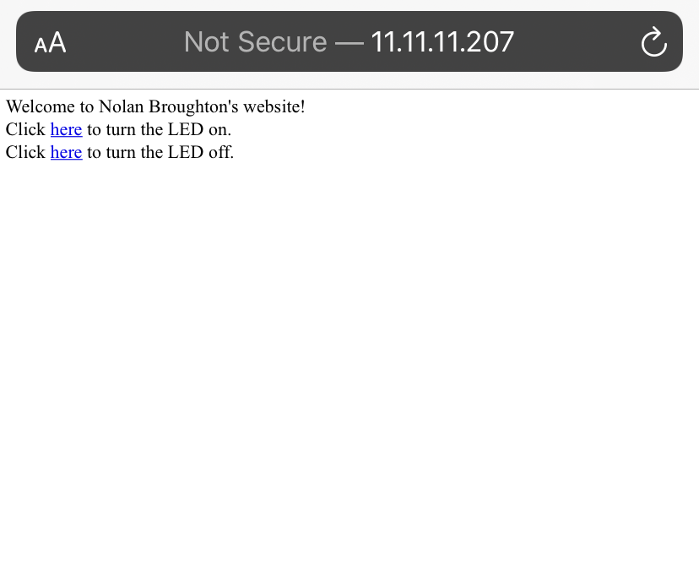
Picture of webpage

Slide 26
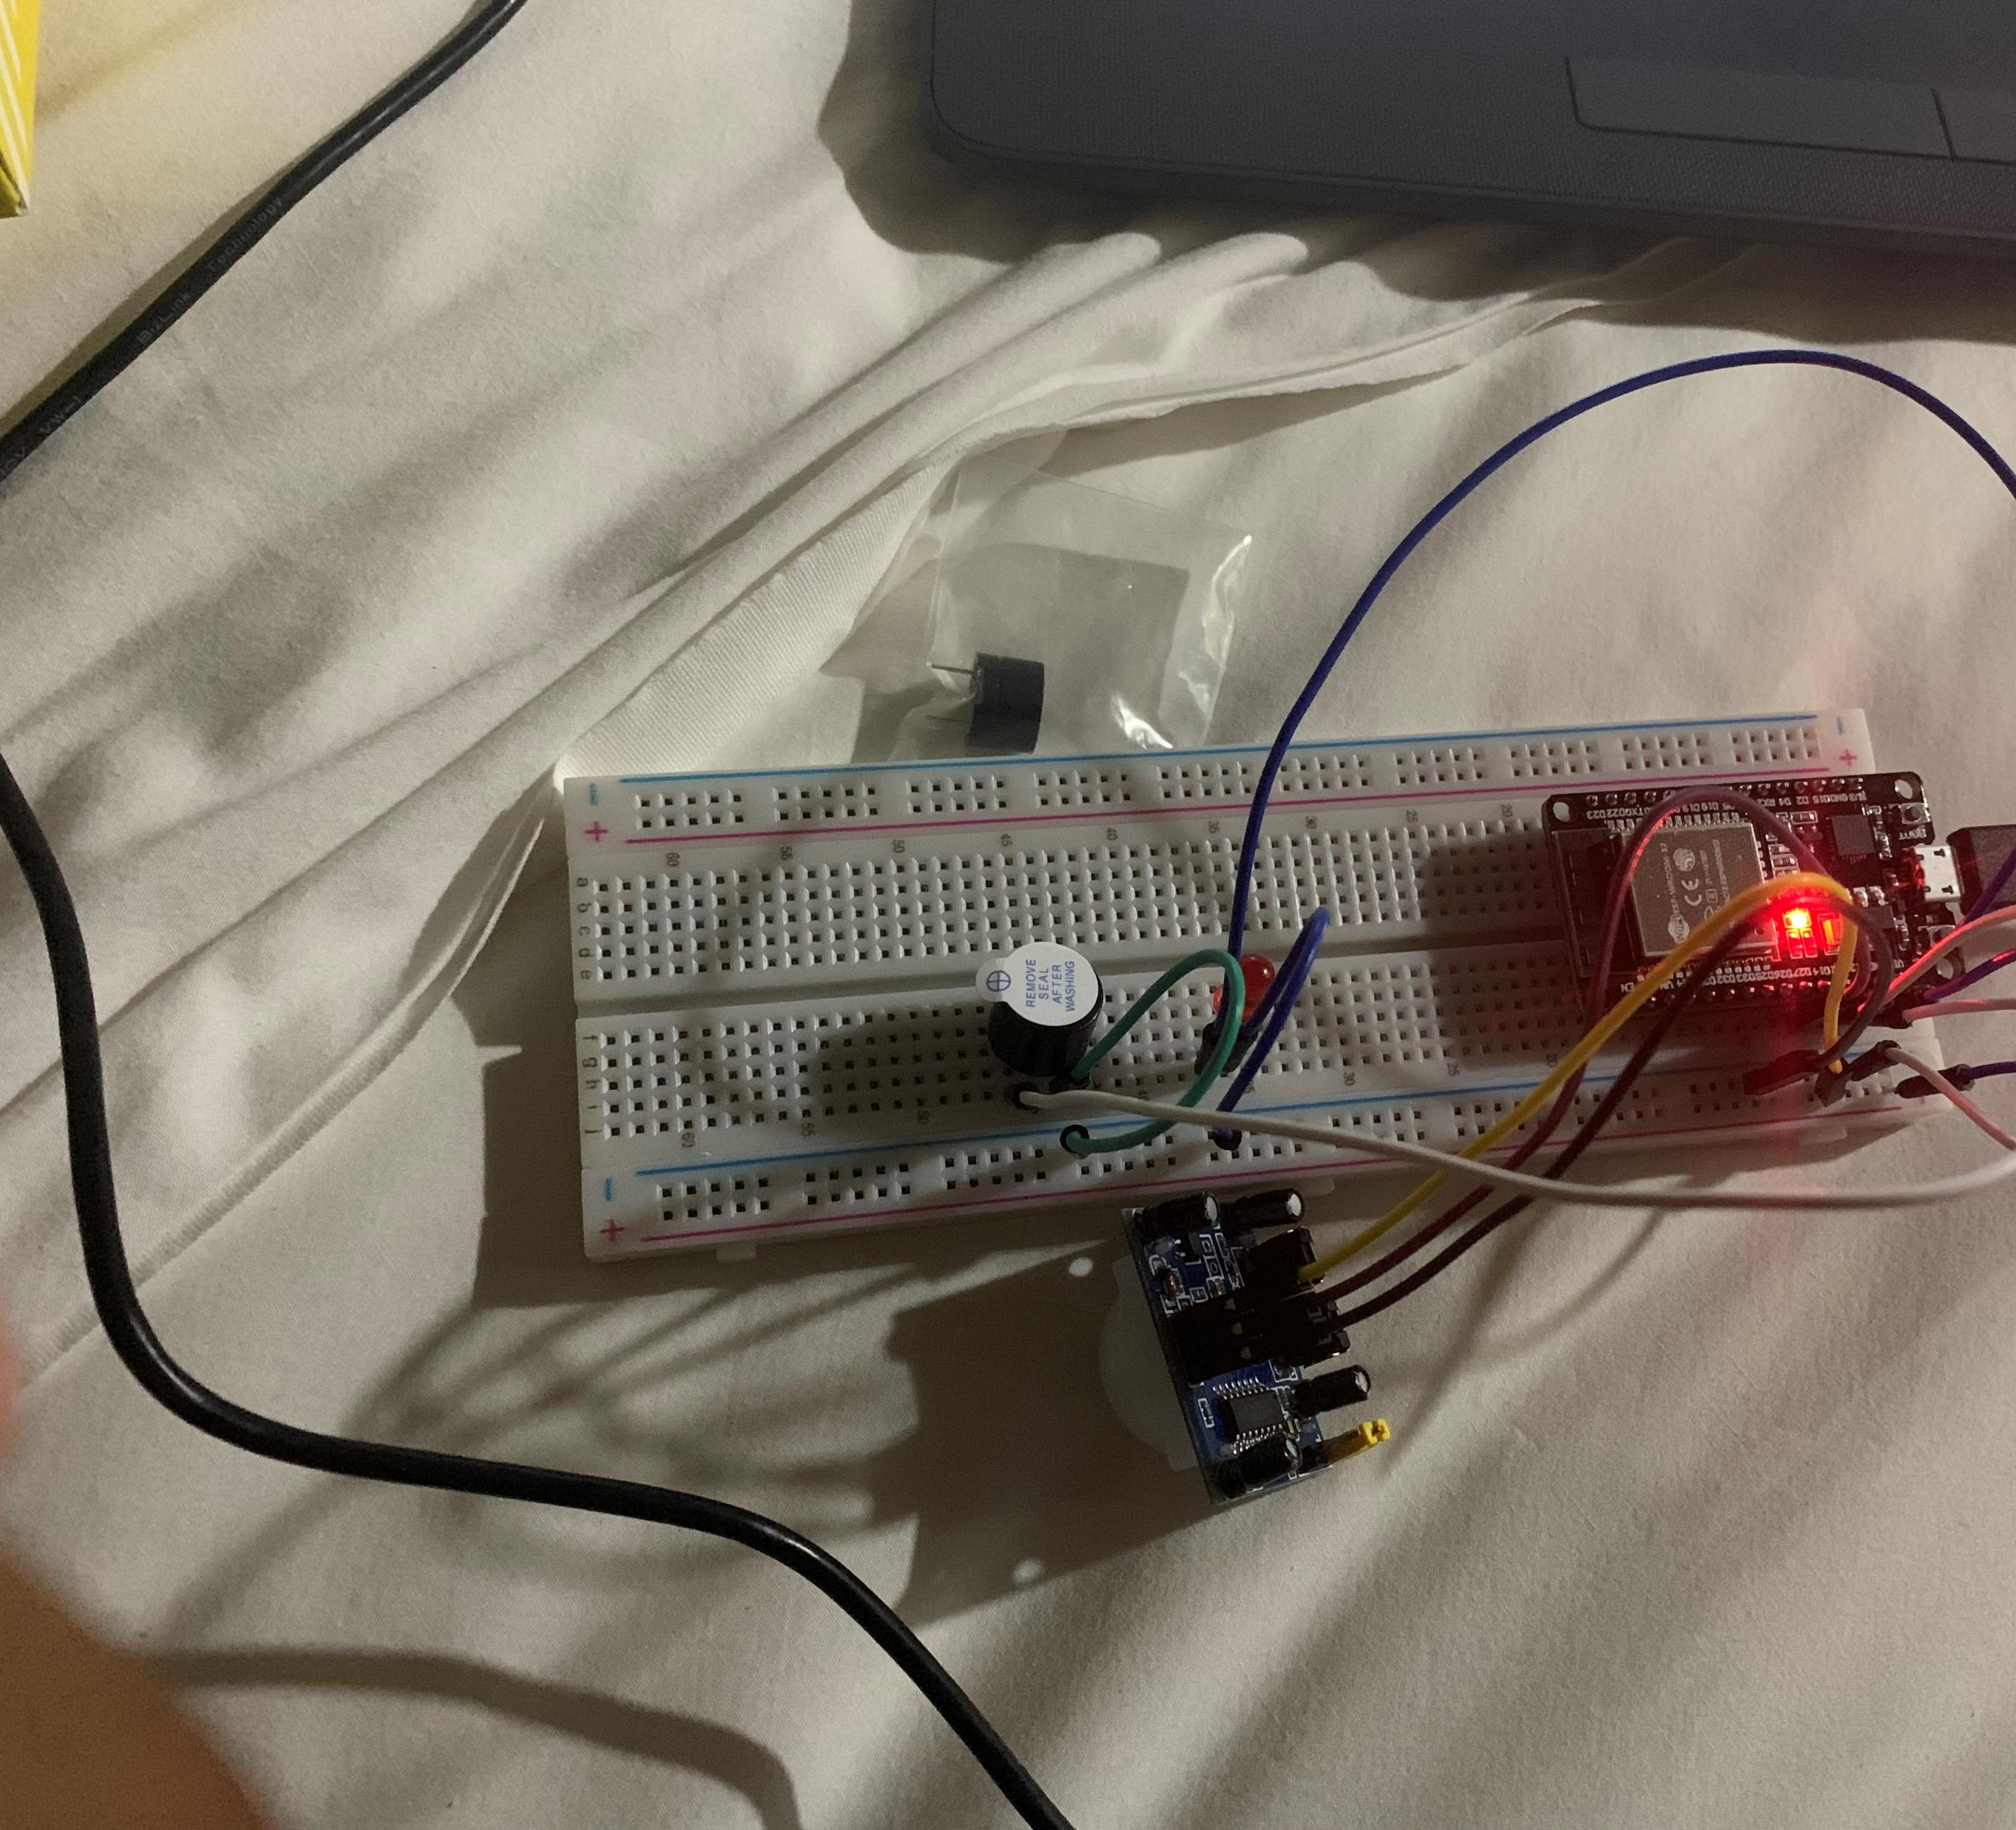
Finished Product

Slide 27
Challenges
Some of the challenges I faced are as follows
I was having a Problem with getting the code to work when I first started I fixed this by going and making sure all my wires were hooked up properly and by making sure in Arduino I was in the right port and had the right board selected

Slide 28
Career skills
Several career skills gained in this project
Communication using flowcharts to depict the plan of a project
Electronics (voltage, resonance, current) and working with the Arduino
Programming using the Arduino IDE
Networking – setting up the Router
Security- setting the password on the router to secure password

Slide 29

Conclusion
In conclusion I was able to successfully achieve my goals which was to combines an aspect of the internet of things to develop a home security system
Also to Hook the home security system up to a Network

